Slide 1
Generating the Future:
Exploring the Power of Generative AI
The better the question. The better the answer. The better the world works.

Slide 2

About me!
Machine Learning Training
INSAT
Networks & Telecommunications engineer
(Sep 2016 - Oct 2021)
Specialty: Multimedia & Data Science
INSAT, EPT, Sup’COM, ENIT, ENIS, ENSTAB (2020-2022), MLAct (2023)
Data Co-lab
AI Specialty
Student (Feb 2020)
Instructor (Since Oct 2020)
Natural Language Processing (NLP)
Internships in Data Science
EY Tunisia/EY Canada
Data Consultant – Technology Solution Delivery (Microsoft Team)
Epilert (Jul-Sep 2020)
TRITUX (Mar-Aug 2021)

Slide 3
Demystifying AI: Concepts & Applications
“Our intelligence is what makes us human, and AI is an extension of that quality.” – Yann LeCun

Slide 4


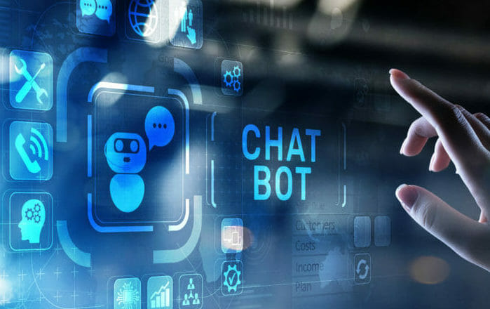
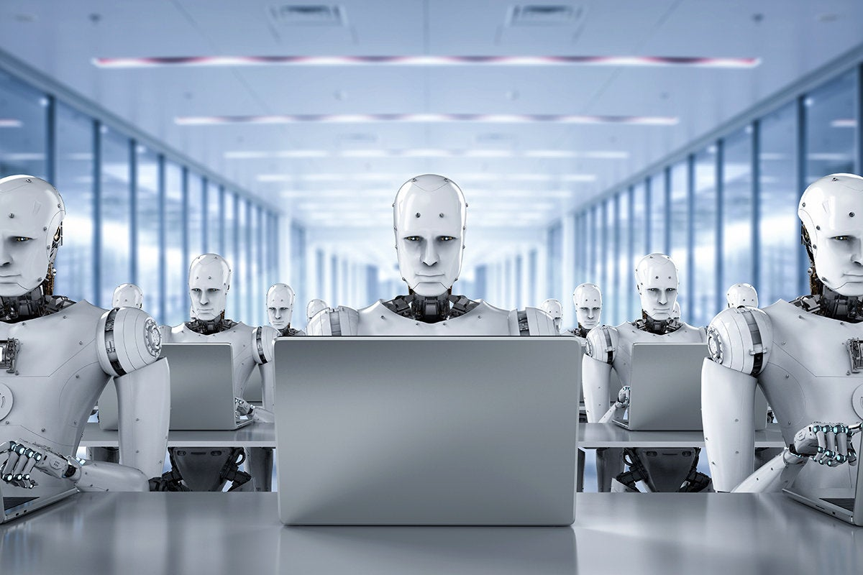
Artificial Intelligence: Unlocking Human-like Intelligence.
Demystifying AI: Concepts & Applications
Spam Detection
Recommendation Systems
Artificial Intelligence is a Computer Science branch that involves creating intelligent systems that can think and act like humans. Highlighting remarkable real-world applications of AI, we present notable examples including Spam Detection Tools, Recommendation Systems, Chatbots and Coding Assistants.
Chatbots
Coding Assistants

Slide 5
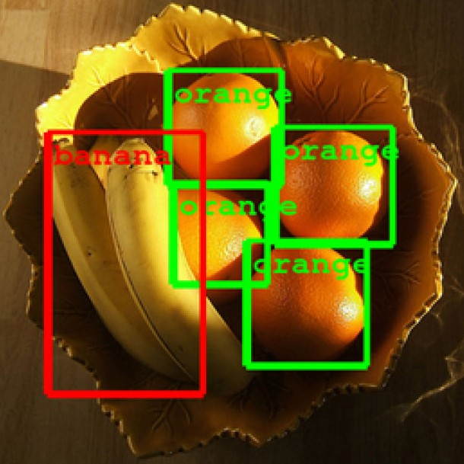
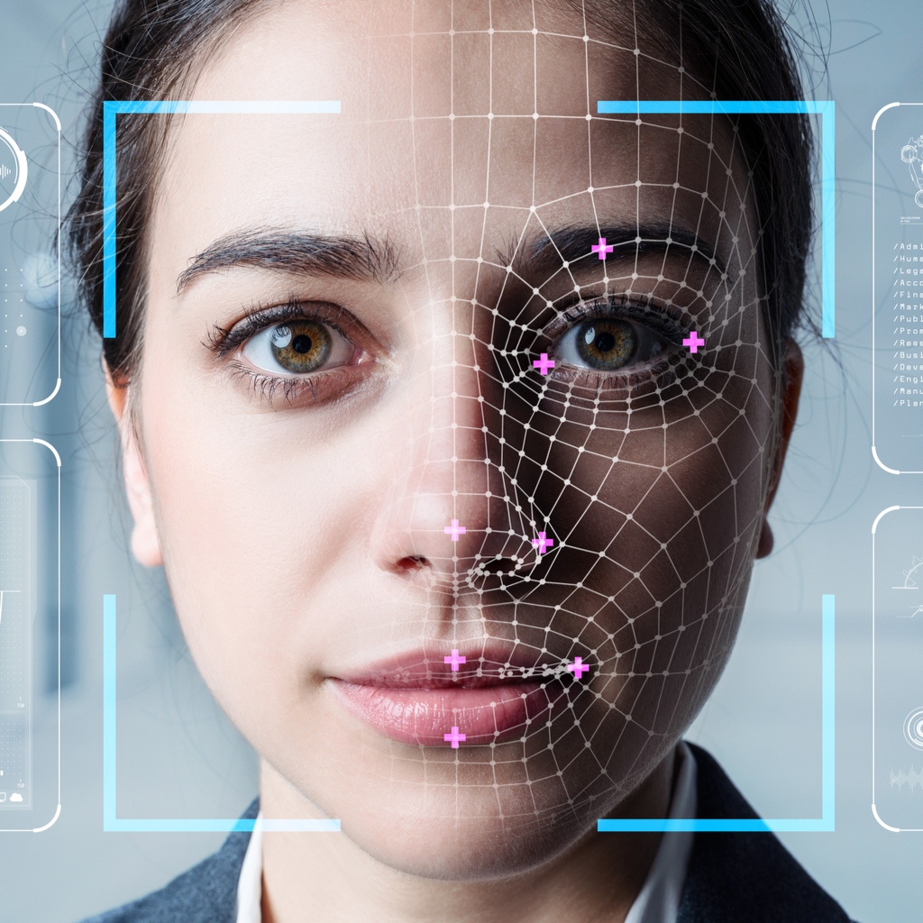
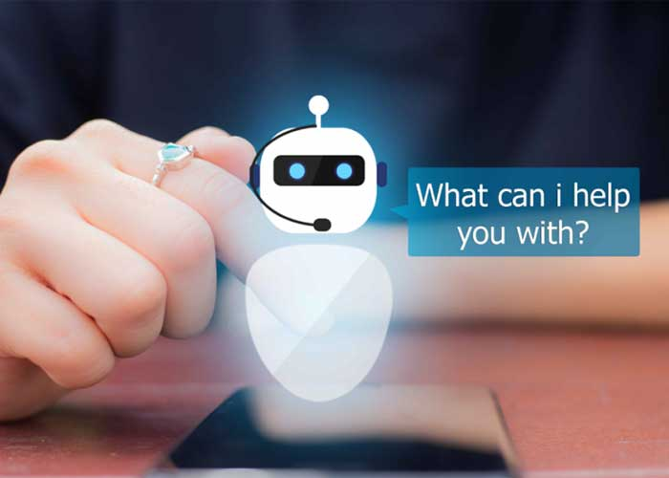
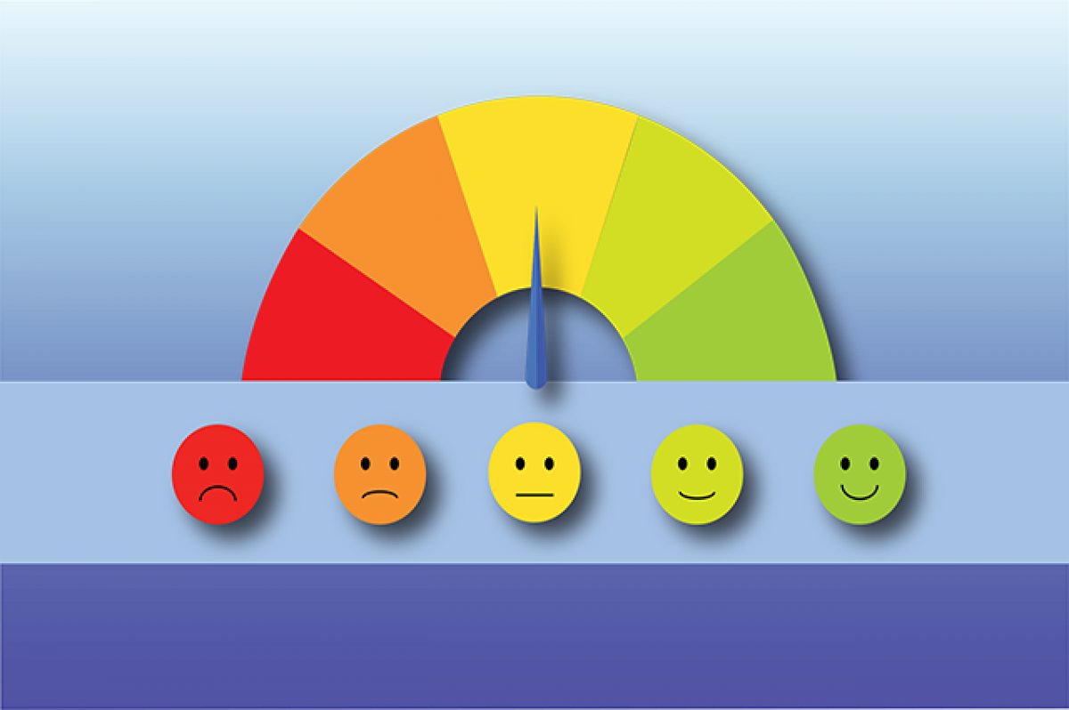

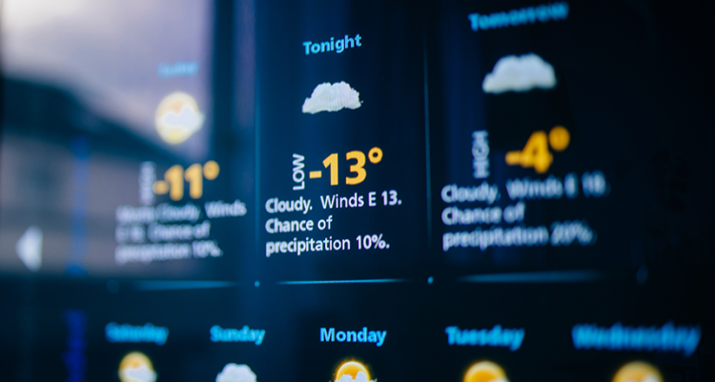
Exploring Key Domains of AI
Demystifying AI: Concepts & Applications
Computer Vision
Computer Vision:
Enabling computers to understand and interpret visual information from images or videos.
Natural Language Processing (NLP):
Focus on the interaction between computers and human language.
Time Series Analysis/Prediction:
Analyzing and forecasting data that is ordered chronologically (time-stamped).
Object Detection
Facial Recognition
Natural Language Processing
Time Series Analysis/ Prediction
Chatbots
Sentiment Analysis
Volatility of Cryptocurrency
Weather Forecasting

Slide 6
Navigating the AI continuum
Demystifying AI: Concepts & Applications
Encompasses various techniques, algorithms, and approaches to enable machines to simulate human intelligence.
Artificial Intelligence
Machine Learning
Development of programs that train models to make useful predictions using input data. The models involved are usually statistical models.
Deep Learning
Development of programs that train Artificial Neural Networks (ANN) to make useful predictions using input data.

Slide 7
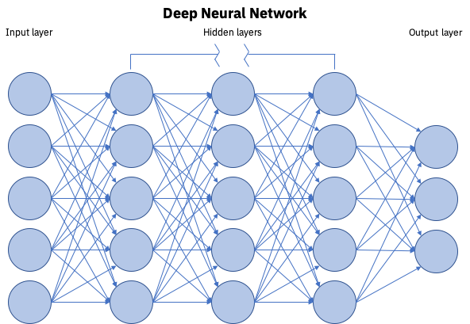
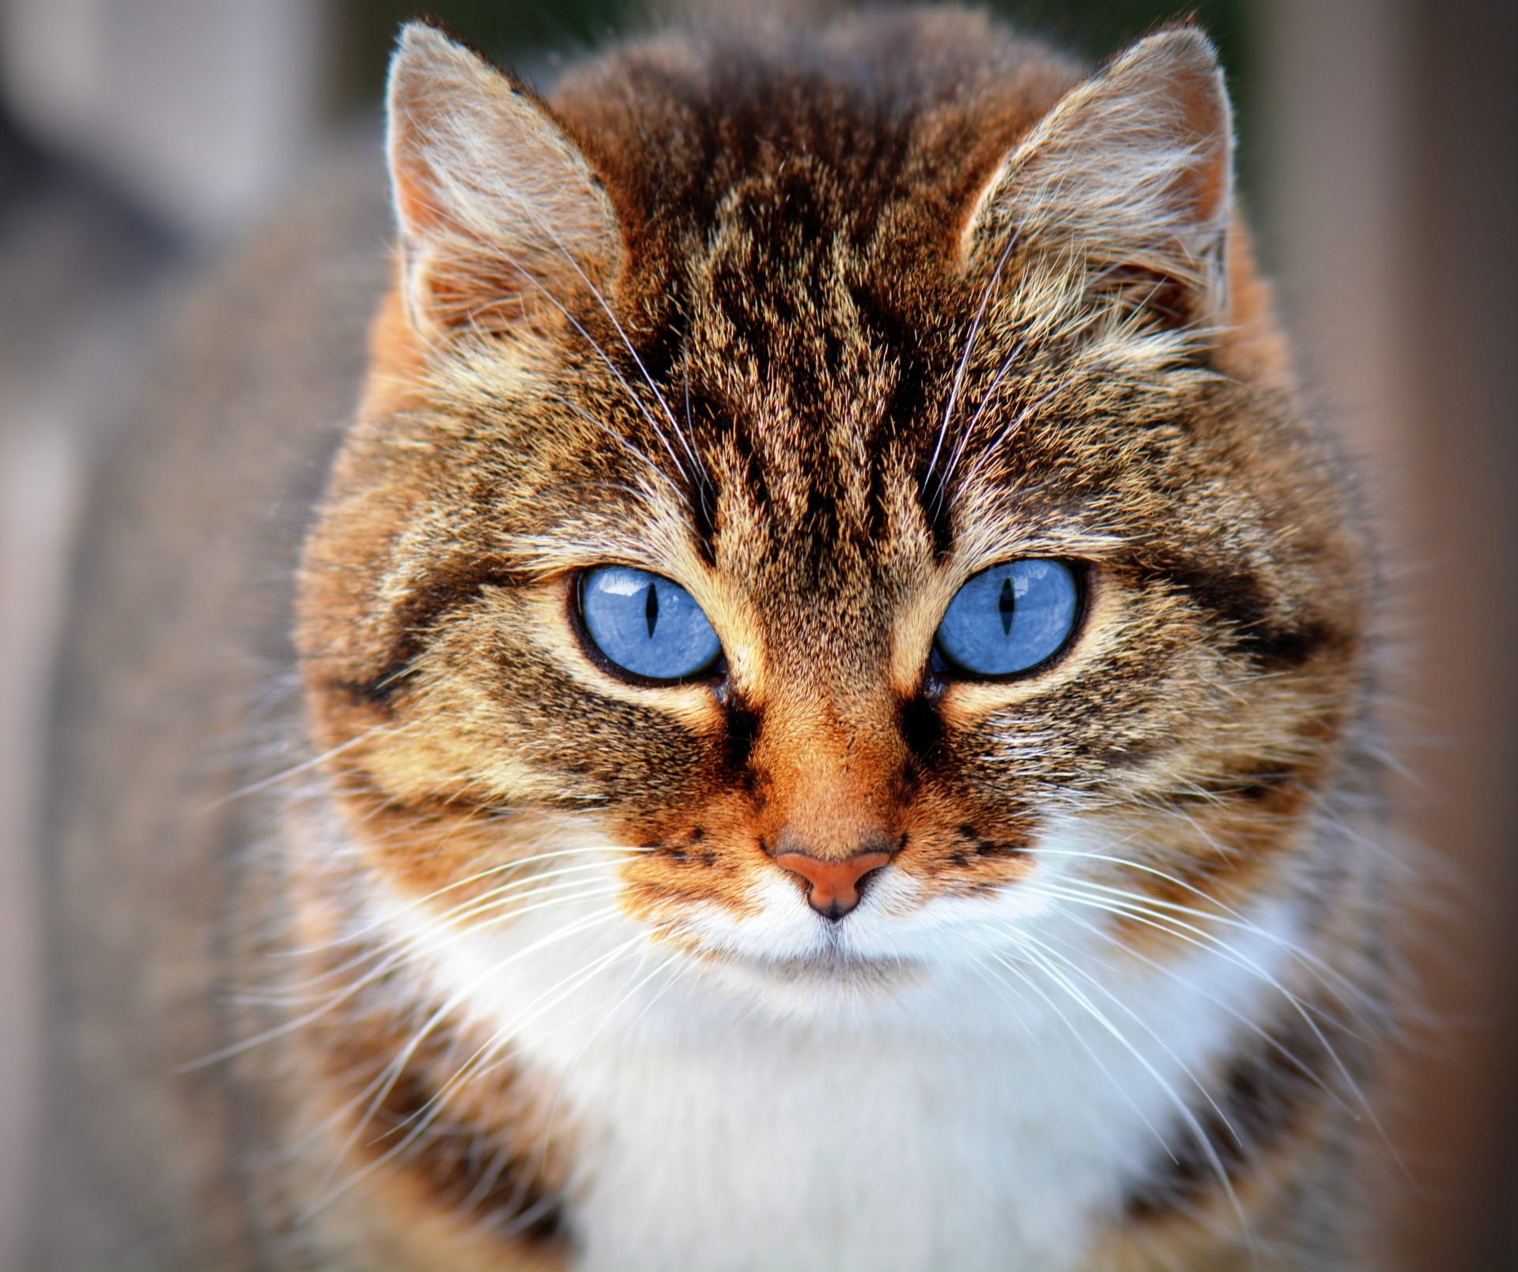
Navigating the AI continuum: Image Classification using ANNs
Demystifying AI: Concepts & Applications
Probabilities
0,95
Cat
0,01
Dog
0,04
Lion

Slide 8
Navigating the AI continuum
Demystifying AI: Concepts & Applications
Encompasses various techniques, algorithms, and approaches to enable machines to simulate human intelligence.
Artificial Intelligence
Machine Learning
Development of programs that train models to make useful predictions using input data. The models involved are usually statistical models.
Deep Learning
Generative AI
Development of programs that train Artificial Neural Networks (ANN) to make useful predictions using input data.
Notes:
Explaining here that Generative AI is a Subset of Deep Learning which means it’s based on Neural Networks Architectures

Slide 9
Evolution of Neural Networks: From Discriminative to Generative Models
Demystifying AI: Concepts & Applications
Deep Learning
They aim to directly model the mapping from input data to output labels without explicitly modeling the underlying probability distribution of the data.
Discriminative (traditional) Models
Generative Models
They aim to learn the underlying probability distribution of the input data, so that they can generate new data samples by sampling from the learned probability distribution
Generative Models

Slide 10
Generative AI: Transforming Creativity and Beyond
“Generative AI is a glimpse into the infinite potential of human creativity amplified by intelligent machines.” – ChatGPT

Slide 11
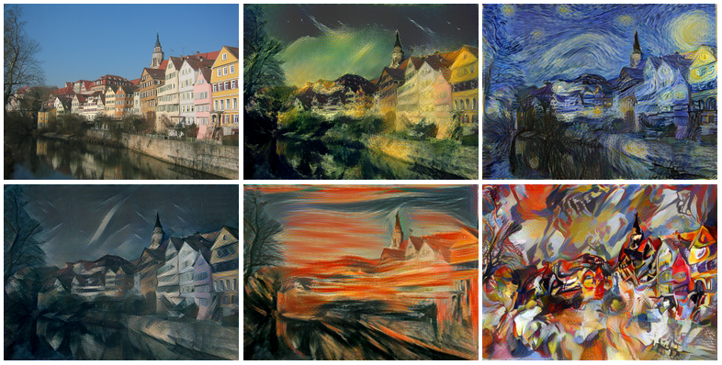


The Art of Creation: An Introduction to Generative AI
Generative AI: Transforming Creativity and Beyond
Image Synthesis
It refers to a branch of artificial intelligence that focuses on creating computer systems capable of generating new content, such as images, text, music, or even videos.
Generative AI models can learn to create realistic and coherent outputs, leading to applications such as image synthesis, text generation, music composition, and more.
Style Transfer
Text Generation
Video Game Development
Language Translation
Creation of Animations/Characters

Slide 12






Generative AI for Everyone: Empowering Daily Creativity
Generative AI: Transforming Creativity and Beyond
Text Generation
Image Synthesis
Github Copilot
ChatGPT
DeepL
Designs.ai
Deep Art Effects
DALL-E
Code Completion
Conversational AI
Language Translation
Content Creation
Style Transfer
Art Generation

Slide 13
Generative AI Models: A Multifaceted Spectrum
Generative AI: Transforming Creativity and Beyond
Generative AI NN Architectures
GANs (Generative Adversarial Networks)
Transformers
Probabilistic Graphical Models
Notes:
Add examples for each architecture.

Slide 14

Generative AI Models: Transformers
Generative AI: Transforming Creativity and Beyond

Slide 15
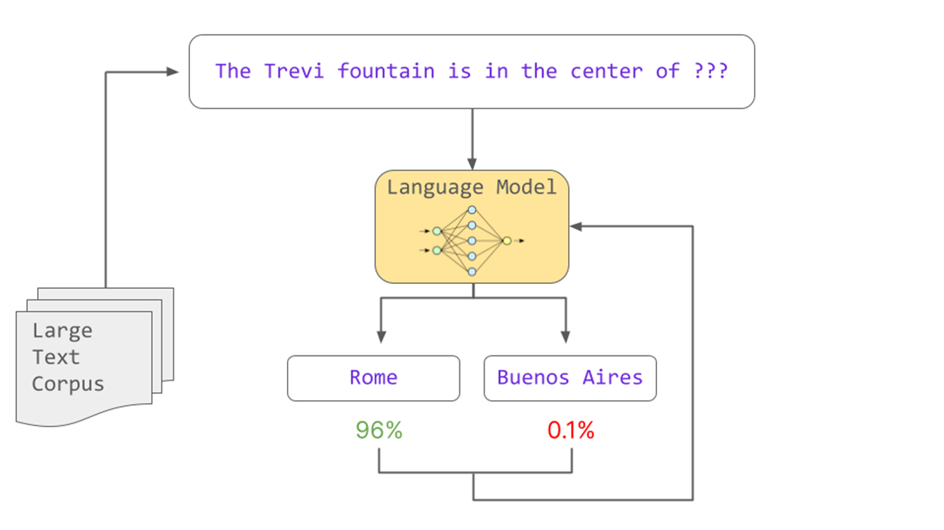
Large Language Models as Generative Powerhouses
Generative AI: Transforming Creativity and Beyond
Prompt
Built on top of Transformers
Output
Notes:
LLMs provide a layer of abstraction

Slide 16
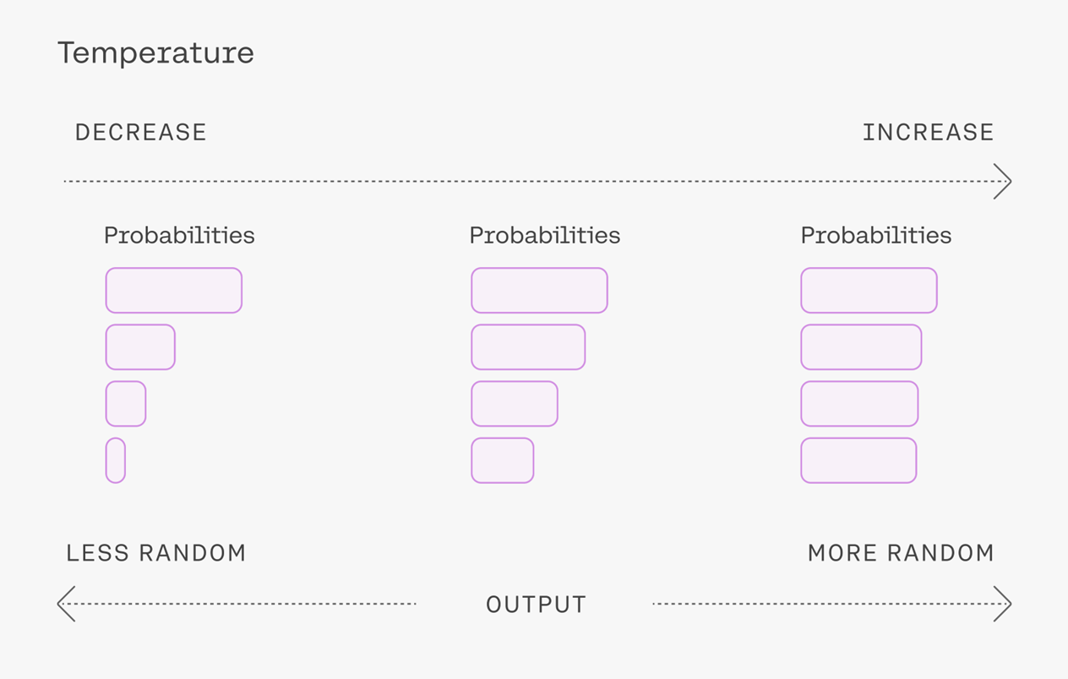
LLMs Parameters: Navigating the Temperature Spectrum
Generative AI: Transforming Creativity and Beyond
Notes:
Add params

Slide 17



Setting the Benchmark: State-of-the-Art LLMs
Generative AI: Transforming Creativity and Beyond
GPT3.5/ GPT4
PalM
LLaMa/LLaMa2
Notes:
Add :
Nb parameters (internal)
Size
Pricing (Open Source or not)
Layer of abstraction (params)

Slide 18
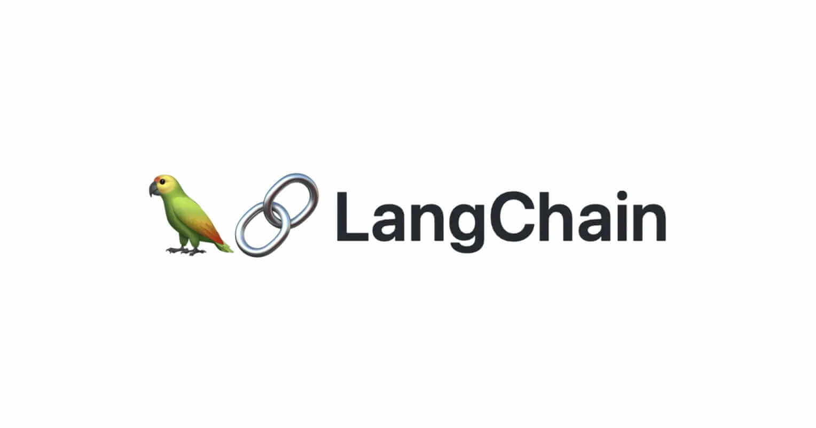
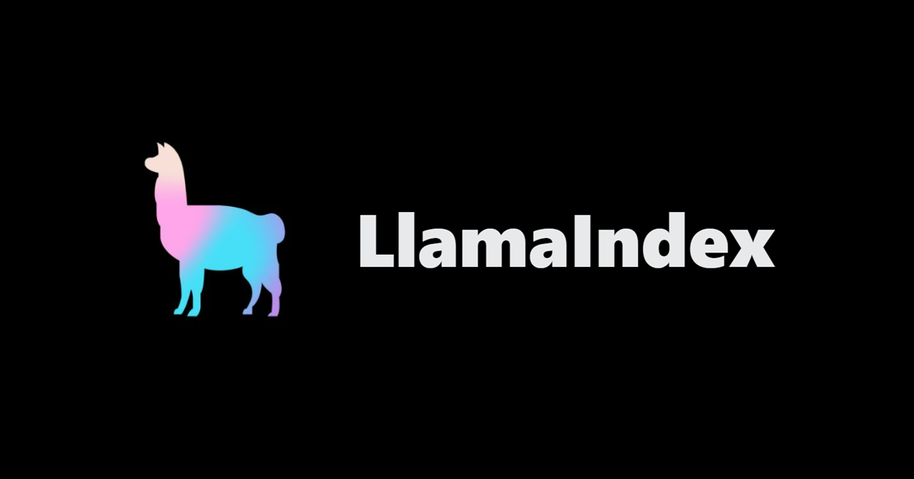
Building LLM based applications with ready-to-use components
Generative AI: Transforming Creativity and Beyond
Frameworks for LLM based Applications
LangChain
LlamaIndex

Slide 19
Enough Talking, Let’s Code!
“Knowledge is of no value unless you put it into practice.” – Anton Chekhov

Slide 20
Thank you for your attention!
“Successful presentations are understandable, memorable, and emotional.” – Carmine Gallo

Slide 21






Generative AI in Action: Code Conversion
Generative AI: Transforming Creativity and Beyond
Prompt Engineering
Model Selection
Candidats generation
& champion selection
Code correction
& Final Testing

Slide 22






Generative AI in Action: FiscaBot
Generative AI: Transforming Creativity and Beyond
Load Documents
(PDF, TXT … )
Text extraction & processing
Text encoding
Storage in vector stores (embedding databases)
Similarity search
(Top K similar)
Feed the prompt

